Slide 1


Redcar and Cleveland
Making Attendance Everyone’s Business
Monday 2 June 2025

Slide 2
Agenda
To share the themes of the emerging MAEB Strategic Framework for Action
To discuss the rationale and purpose of Action Groups
To explore the proposal for co-leadership of the Action Groups and support needs
To agree how Action Groups can devise meaningful Action Plans in 2025
To consider investment and leveraging opportunities to implement the plans in Redcar and Cleveland

Slide 3
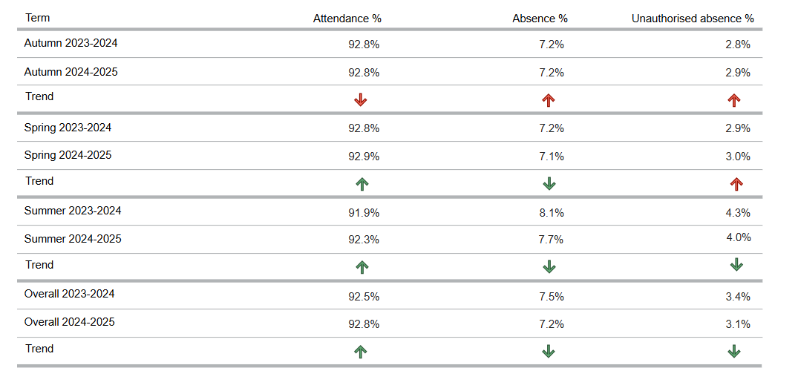
Termly breakdown attendance data
Redcar & Cleveland

Slide 4
Year to date attendance data – Week 14
Redcar & Cleveland
Primary Absence:
Redcar & Cleveland National Regional
Total: 5.14% 5.2% 5.03%
Auth: 3.35% 3.84% 3.57%
Unauth: 1.79% 1.36% 1.46%
PA: 13.07% 13.76% 13.28%
Secondary Absence:
Redcar & Cleveland National Regional
Total: 8.96% 8.28% 8.95%
Auth: 4.74% 5.2% 4.95%
Unauth: 4.22% 3.09% 4%
PA: 24.06% 22.7% 24.66%
Special Absence:
Redcar & Cleveland National Regional
Total: 12.62% 12.87% 12.62%
Auth: 10.02% 9.65% 8.35%
Unauth: 2.6% 3.23% 4.26%
PA: 36.34% 35.42% 31.89%
Notes:
(week commencing 28th April 2025)

Slide 5
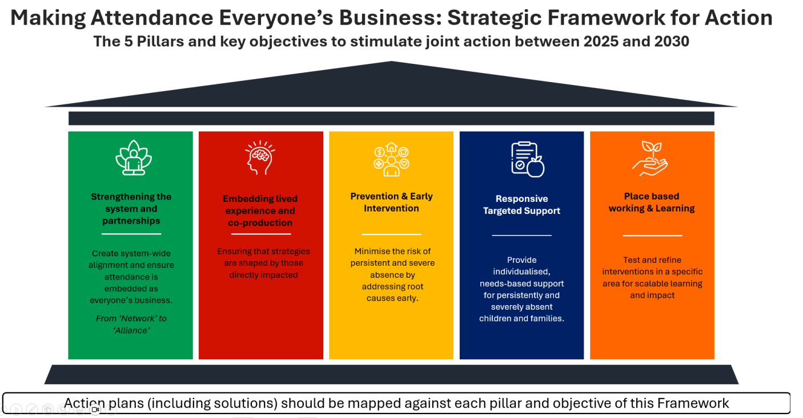
Caseload NEET Leavers and Joiners
Year 12 and 13 year to date (March 2025)
Action plans (including solutions) should be mapped against each pillar and objective of this framework
Notes:
Have intentionally created a framework for action, as opposed to strategy. We wanted to create a dynamic document that will constantly change, based on what we learn so it becomes iterative. The framework details 50 action domains, these are suggested and don’t yet have the where, when and who as individual action plans will be created in each thematic groups and we will discuss prioritisation later. The framework has been shaped by our collaborative work over the past 2.5 years, so all the collection or data, lived experience, workshop etc and it details that journey. We have provided you with an abridged version and the action domains, but plan to send out the whole document for consultation. This is being balanced with meeting statutory duties and very clearly defined roles and responsibilities set out in the DfE’s Working Together to Improve Attendance and we have an action plan in place to get us where we need to be as a Borough, so for example accelerating the termly conversations with schools but we also need to ensure these are meaningful for everybody.
This slide highlights the 5 pillars that all action plans should be mapped against. Again, these are reflective of the contributions of over 300 partners and 700+ contacts.
Can you have a look at these in your groups and see if you agree?
Following this discuss resources

Slide 6
Making Attendance Everyone’s Business
Co-Leadership Session: Items 2 & 3
Discuss the rationale and purpose of the Action Groups
Explore the proposal for co-leadership of the Action Groups and support needs

Slide 7

What is co-leadership?
Co-leadership is a leadership model in which two or more people share responsibility and authority for guiding a team, project, organisation, or initiative.
Rather than having a single leader at the top, co-leadership involves shared decision-making, distributed power, and collaborative leadership practices.
Co-leaders provide each other with support, feedback, and a sounding board, which can enhance leadership resilience.
Co-leadership can be powerful, but it also requires strong communication, trust, and clear expectations to avoid confusion or conflict.
Notes:
Co-leadership typically involves:
Shared Accountability: Both (or all) leaders are equally responsible for the outcomes and the well-being of the team or project.
Diverse Perspectives: Co-leaders often bring complementary skills, experiences, and viewpoints to the table, enriching decision-making and problem-solving.
Collaborative Decision-Making: Instead of a top-down approach, decisions are made jointly, with input from all co-leaders.
Clarity: While co-leaders share responsibility, they often have different but complementary roles. For example, one might focus on external partnerships while another focuses on internal team dynamics.
Mutual Support: Co-leaders provide each other with support, feedback, and a sounding board, which can enhance leadership resilience.
Examples of co-leadership might include:
Two project leads jointly managing a large initiative.
A CEO and COO sharing executive leadership.
Co-chairs of a community board or working group.

Slide 8
Making Attendance Everyone’s Business
Members of the Redcar & Cleveland Attendance Alliance
Strategically themed co-leadership action groups (individual action plans)
MAEB Co-Leadership Action Group (ensuring connectivity between individual action plans)
RCBC Leadership
Education
Statutory services
Voluntary & community sector
Lived experience

Slide 9
Proposal
Cross-cutting themes:
Relational practice
Investment & leverage
Safety
Lived experience, parent/carer engagement and communications
Mentoring, peer support and coaching solutions
Targeted support and caseload management solutions
Health and attendance
Place-based pilot
Creativity, cultural and joyful interventions
Co-leadership for each of the thematic solutions showing most promise to address absence.
c3-4 people co-leading each of the 6 groups.
C3-4 people co-leading the cross-cutting relational practice theme.
Core of 20-30 people that form a ‘backbone’ for catalysing the action planning process in 2025/26.

Slide 10
Action Groups: purpose and way forward
The core of 3-4 people take responsibility for developing a prioritised action plan (for their theme)
They will shape their action plan with other willing members of the wider Alliance
The prioritised actions will align with at least one of the 5 strategic pillars of the new Framework for Positive Action on Attendance
The core 3-4 people decide the way in which they would like to engage other members of the Alliance to shape their action plan e.g. how and who to invite from the wider Alliance to support the task
The core 3-4 people get support from RCBC to reach Alliance members, convene and guide as welcomed

Slide 11
Suggested milestones
Action planning process takes place between June and October 2025.
Meetings, action plan templates & simple guidance can be facilitated online with support from RCBC as welcomed.
At least one online action planning session per group to be facilitated by the end of September (but more if the momentum is there).
The Co-Leadership Group (people attending today) reconvene again in mid-October for a dedicated half-day action planning session with their other Action Group ‘members’ or contributors (Inspire to Learn).
Action plans collated into one document of prioritised actions in November.
Co-leaders agree to present action plan priorities at a December in-person event for the whole Alliance.

Slide 12
Group discussion
Items 2 & 3 Co-leadership approach, Action Groups and Action Plans
What are the pros and cons of the suggested co-leadership approach?
01
What practical support would you need to go from today to drafting a (thematic) action plan with others in the Alliance ready to share in December?
02
What would be better than the proposal in front of us?
Who isn’t in the room today that should be?
03
Notes:
What would be better than the proposal in front of us, for example, there isn’t a paid, dedicated ‘backbone organisation’ driving the MAEB Project longer-term and we don’t have a dedicated investment pot to activate the Framework)
Who isn’t in the room today, but you think should be given the proposal?

Slide 13

10-minute comfort break!

Slide 14
Making Attendance Everyone’s Business
Co-Leadership Session: Items 4 & 5
Action Planning
Leverage and investment

Slide 15

Action Planning
Quick discussion
Who here has been responsible for or had experience of putting an action plan together?
What worked well?
Any cautionary tales?

Slide 16

Getting from here to December
Today we will:
Get familiar with the relevant documentation.
Use a couple of action planning tools.
Seek to prioritise 3 actions for your solutions theme.
What we don’t do today is populate a full action plan!!!!

Slide 17

The relevant documentation
The new Framework for Positive Action on Attendance
5 strategic ‘pillars’
C10 ‘action domains’ for each of those 5 pillars
The ‘solutions pack’
Ideas generated by the Alliance including action plan suggestions
Health & Attendance
An additional paper detailing action planning ideas crafted this year
Lived Experience, parent/carer engagement and communications
An additional paper detailing action planning ideas crafted this year

Slide 18
Action Plan – Traditional layout
Action Area / Idea | Strategic / Framework alignment | Lead Organisation/Person | Resources Required | Milestones & Timeline | Success Measures
Example: Establish a parent champion network for attendance | Pillars 2 and 3 | Local VCSE partner / trusted lived experience organisation (LEO) | Parent volunteers, training budget | Launch by Oct 2025; Review Jan 2026 | 10 parent champions trained; feedback from parents improved by 20%

Slide 19
Task for today
In your small groups:
Rapid review the action domains in the Framework
Circle any that you think are a priority given your solutions theme
Make a note of their numbers e.g. 1.2 2.3. or 3.4, 4.5, 5.6 etc
Then look at the relevant ideas found in the ‘solutions pack’ for your theme and :
Discuss / locate what you feel are the ‘best’ actionable ideas
Write between 3 and 5 down in total that you think you want to prioritise

Slide 20
Got your 3-5 actions?
 | High Effort | Low Effort
High Impact | Major strategic focus | Quick wins – prioritise
Low Impact | Park or reconsider | Optional actions
Plot each of your 3-5 actions on the relevant part of the grid
What we’re looking for today (we think) are those you determine as High Impact – Low Effort (quick wins) and High-Impact-High Effort (major strategic focus)

Slide 21
And now we need to ‘RAFT’!
Now for the same 3-5 actions consider:
Relevance: Is this aligned to one of the 5 strategic objectives (the ‘pillars’ in the Framework)
Acceptability: Will this gain buy-in from key stakeholders?
Feasibility: Can we deliver this with current or accessible resources?
Timing: Is this the right time for this action?
Has this helped you identify which actions you would like to focus on – be ready to share at least one action back with the group

Slide 22
Group discussion
How do we leverage opportunities and investment to activate the Framework for Action and more detailed action plans that we develop together?
01
How do we get maximum buy-in for the Framework and the emerging action plans?
02
How do we make this fly?
03

Slide 23
Thank you
Next steps

